Slide 1

OPERATING SYSTEMS
Process Management
Venkatesh Prasad
Department of Computer Science

Slide 2

OPERATING SYSTEMS
Slides Credits for all PPTs of this course
The slides/diagrams in this course are an adaptation, combination, and enhancement of material from the following resources and persons:
Slides of Operating System Concepts, Abraham Silberschatz, Peter Baer Galvin, Greg Gagne - 9th edition 2013 and some slides from 10th edition 2018
Some conceptual text and diagram from Operating Systems - Internals and Design Principles, William Stallings, 9th edition 2018
Some presentation transcripts from A. Frank – P. Weisberg
Some conceptual text from Operating Systems: Three Easy Pieces, Remzi Arpaci-Dusseau, Andrea Arpaci Dusseau

Slide 3
Operating systems
Process Concept
Venkatesh Prasad
Department of Computer Science

Slide 4
OPERATING SYSTEMS
Process Concept
An operating system executes a variety of programs:
Batch system – jobs
Time-shared systems – user programs or tasks
Textbook uses the terms job and process almost interchangeably
Process – a program in execution; process execution must progress in sequential fashion
Multiple parts
The program code, also called text section
Current activity including program counter, processor registers
Stack containing temporary data
Function parameters, return addresses, local variables
Data section containing global variables
Heap containing memory dynamically allocated during run time
Notes:
A process is the unit of work in a system.

Slide 5
OPERATING SYSTEMS
Process Concept
Program is passive entity stored on disk (executable file), process is active
Program becomes process when executable file loaded into memory
Execution of program started via GUI mouse clicks, command line entry of its name, etc
One program can be several processes
Consider multiple users executing the same program

Slide 6
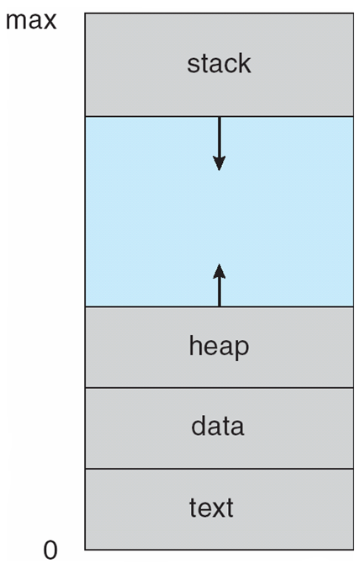
OPERATING SYSTEMS
Process in Memory

Slide 7
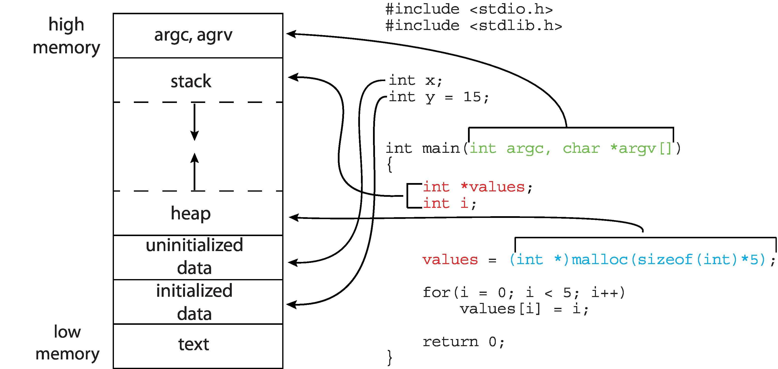
OPERATING SYSTEMS
Memory Layout of a C Program

Slide 8
OPERATING SYSTEMS
Process State
As a process executes, it changes state
New: The process is being created
Running: Instructions are being executed
Waiting: The process is waiting for some event to occur
Ready: The process is waiting to be assigned to a processor
Terminated: The process has finished execution

Slide 9
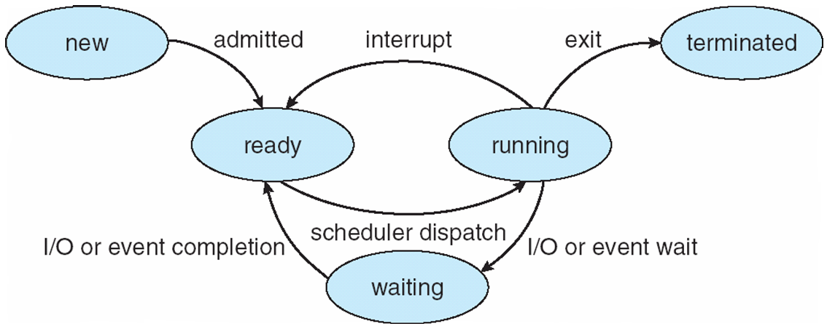
OPERATING SYSTEMS
Process State Diagram

Slide 10
OPERATING SYSTEMS
Process Control Block (PCB)
Information associated with each process (also called task control block)
Process state – running, waiting, etc
Program counter – location of instruction to next execute
CPU registers – contents of all process-centric registers
CPU scheduling information- priorities, scheduling queue pointers
Memory-management information – memory allocated to the process
Accounting information – CPU used, clock time elapsed since start, time limits
I/O status information – I/O devices allocated to process, list of open files

Slide 11
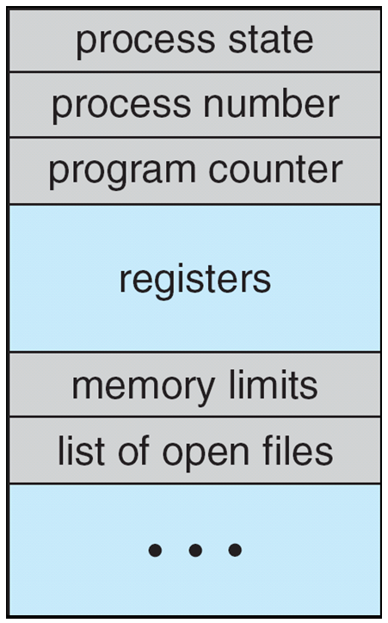
OPERATING SYSTEMS
PCB Representation

Slide 12
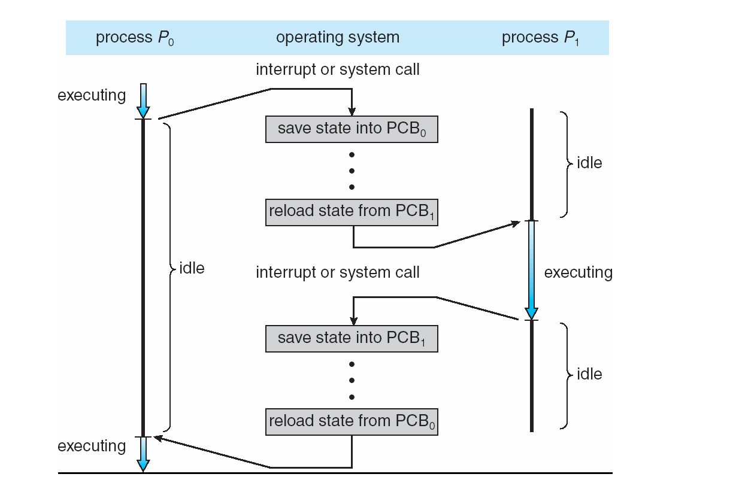
OPERATING SYSTEMS
CPU switch from process to process

Slide 13
OPERATING SYSTEMS
Process Scheduling
Maximize CPU use, quickly switch processes onto CPU for time sharing
Process scheduler selects among available processes for next execution on CPU
Maintains scheduling queues of processes
Job queue – set of all processes in the system
Ready queue – set of all processes residing in main memory, ready and waiting to execute
Device queues – set of processes waiting for an I/O device
Processes migrate among the various queues
Notes:
Ready queue contains PCBs of processes

Slide 14
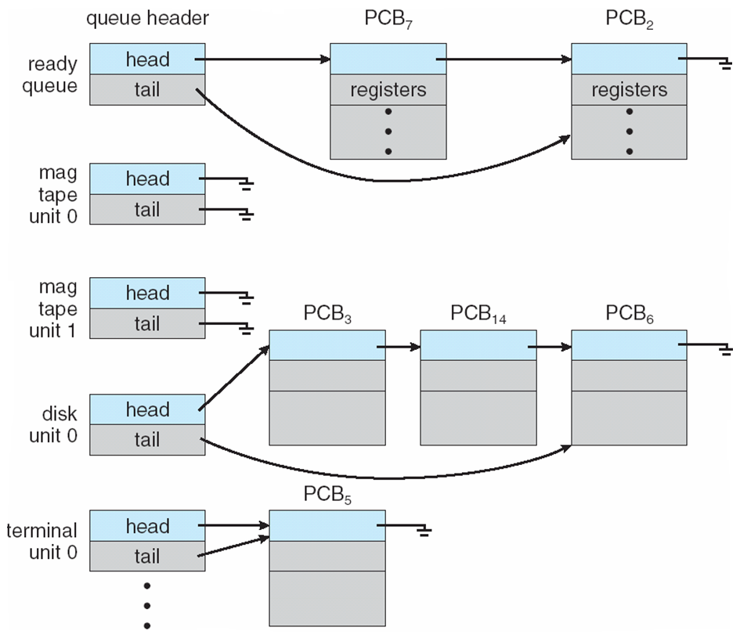
OPERATING SYSTEMS
Ready Queue And Various I/O Device Queues

Slide 15
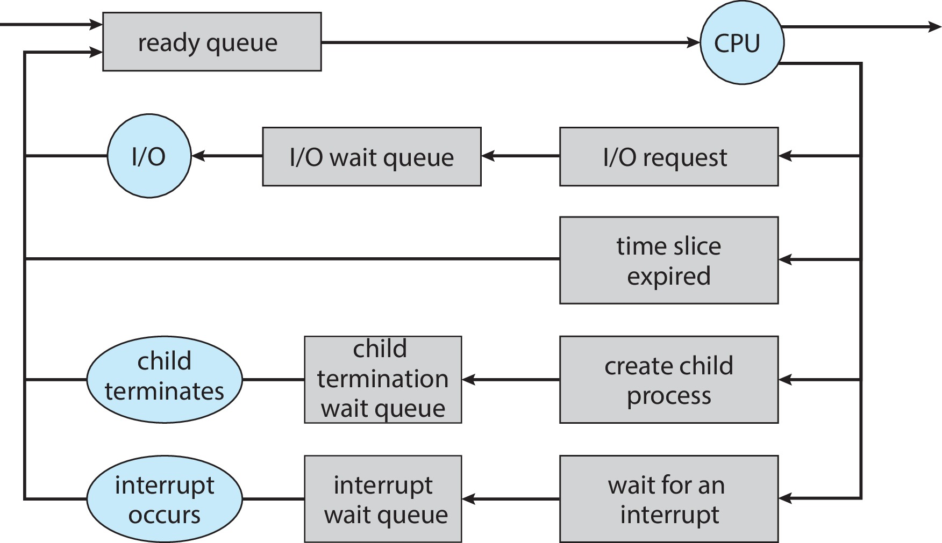
OPERATING SYSTEMS
Representation of Process Scheduling

Slide 16
OPERATING SYSTEMS
Schedulers
Short-term scheduler (or CPU scheduler) – selects which process should be executed next and allocates CPU
Sometimes the only scheduler in a system
Short-term scheduler is invoked frequently (milliseconds) ⇒ (must be fast)
Long-term scheduler (or job scheduler) – selects which processes should be brought into the ready queue
Long-term scheduler is invoked infrequently (seconds, minutes) ⇒ (may be slow)
The long-term scheduler controls the degree of multiprogramming

Slide 17
OPERATING SYSTEMS
Schedulers
Processes can be described as either:
I/O-bound process – spends more time doing I/O than computations, many short CPU bursts
CPU-bound process – spends more time doing computations; few very long CPU bursts
Long-term scheduler strives for good process mix

Slide 18
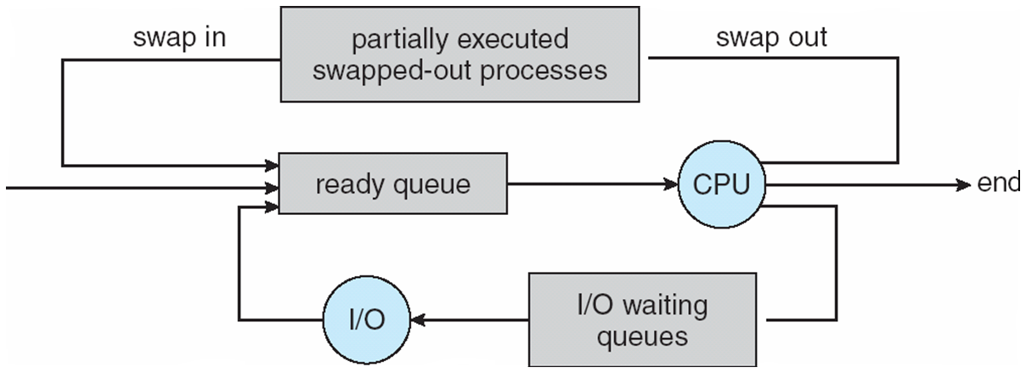
OPERATING SYSTEMS
Representation of Process Scheduling
Medium-term scheduler can be added if degree of multiple programming needs to decrease
Remove process from memory, store on disk, bring back in from disk to continue execution: swapping

Slide 19
OPERATING SYSTEMS
Context Switch
When CPU switches to another process, the system must save the state of the old process and load the saved state for the new process via a context switch
Context of a process represented in the PCB
Context-switch time is overhead; the system does no useful work while switching
The more complex the OS and the PCB ➔ the longer the context switch
Time dependent on hardware support
Some hardware provides multiple sets of registers per CPU ➔ multiple contexts loaded at once

Slide 20
OPERATING SYSTEMS
Operations on Processes
System must provide mechanisms for:
process creation
process termination

Slide 21
OPERATING SYSTEMS
Process Creation
Parent process creates children processes, which, in turn create other processes, forming a tree of processes
Generally, process identified and managed via a process identifier (pid)
Resource sharing options
Parent and children share all resources
Children share subset of parent’s resources
Parent and child share no resources
Execution options
Parent and children execute concurrently
Parent waits until children terminate

Slide 22
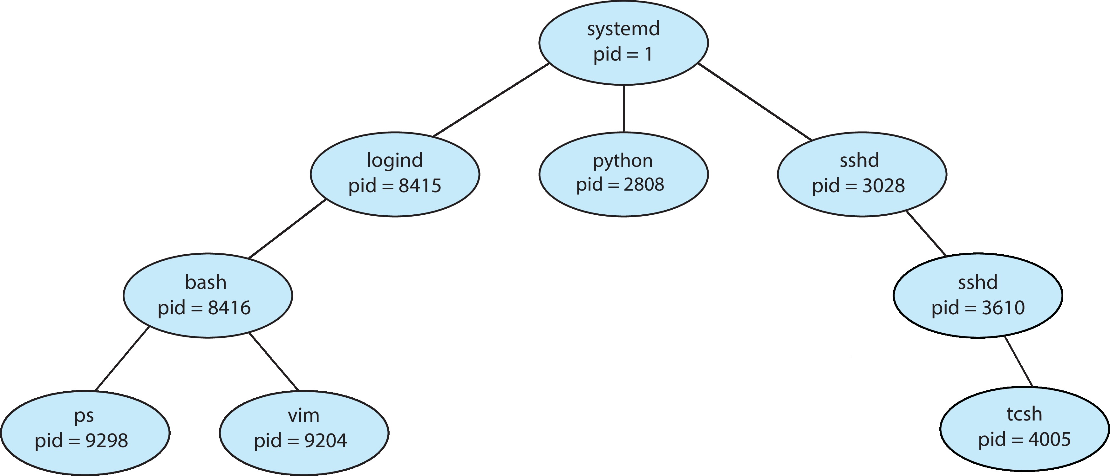
OPERATING SYSTEMS
A tree of processes in Linux

Slide 23
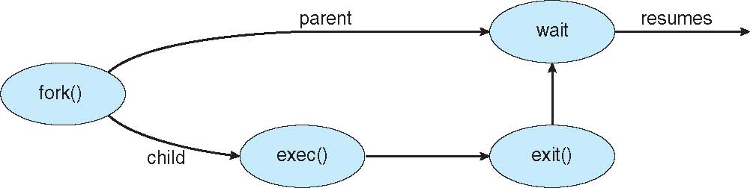
OPERATING SYSTEMS
Process creation using fork()
Address space
Child duplicate of parent
Child has a program loaded into it
UNIX examples
fork() system call creates new process
exec() system call used after a fork() to replace the process’ memory space with a new program

Slide 24
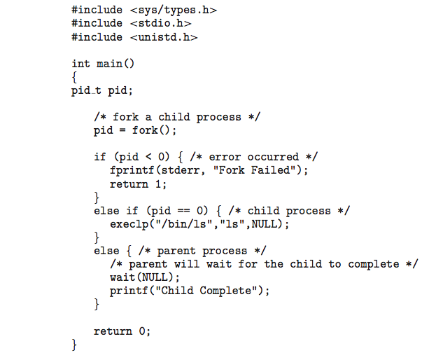
OPERATING SYSTEMS
C Program forking Separate Process

Slide 25
OPERATING SYSTEMS
Process Termination
Process executes last statement and then asks the operating system to delete it using the exit() system call.
Returns status data from child to parent (via wait())
Process’ resources are deallocated by operating system
Parent may terminate the execution of children processes using the abort() system call. Some reasons for doing so:
Child has exceeded allocated resources
Task assigned to child is no longer required
The parent is exiting and the operating systems does not allow a child to continue if its parent terminates

Slide 26
OPERATING SYSTEMS
Process Termination
Some operating systems do not allow child to exist if its parent has terminated. If a process terminates, then all its children must also be terminated.
cascading termination. All children, grandchildren, etc. are terminated.
The termination is initiated by the operating system.
The parent process may wait for termination of a child process by using the wait()system call. The call returns status information and the pid of the terminated process
pid = wait(&status);
If no parent waiting (did not invoke wait()) process is a zombie
If parent terminated without invoking wait , process is an orphan
Notes:
Zombie process – if parent fails to call wait(), zombie will be left in the process table, the kill command has no effect on a zombie process.

Slide 27
THANK YOU
Venkatesh Prasad
Department of Computer Science Engineering
venkateshprasad@pes.edu

